Slide 1
PRSQL-02 MEDICAL DATA HISTORY
NAME: SHADAB HUSSAIN
Medical Database Analysis – Internship Project
“This project involved analyzing a medical database using SQL. The goal was to extract insights related to patients, doctors, admissions, and diagnoses by running a series of 35 structured queries.”
“After getting access to the database using the credentials they provided, I connected to MySQL Workbench and began exploring the tables. I worked on each SQL query one by one, verifying the results. I also visualized the key data using Power BI to make it easier to understand and analyze trends.”

Slide 2
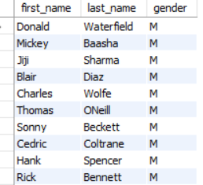
1. Show first name, last name, and gender of patients who's gender is 'M’
Query:
    SELECT first_name,last_name,gender,
    WHERE gender = “M”,

Slide 3
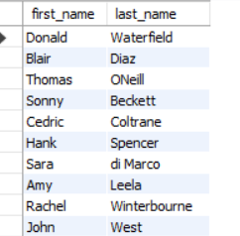
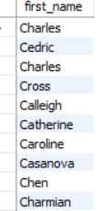
2.Show first name and last name of patients who does not have allergies
SELECT first_name,last_name FROM patients WHERE allergies IS NULL;
3. Show first name of patients that start with the letter 'C'---
SELECT first_name FROM patients WHERE first_name LIKE “C%”;

Slide 4
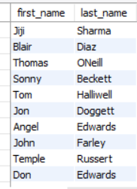
4. Show first name and last name of patients that weight within the range of 100 to 120 (inclusive)
SELECT first_name ,last_name FROM patients WHERE weight BETWEEN 100 AND 120;
OR
SELECT first_name,last_name FROM patients WHERE weight >=100 AND weight <=120;

Slide 5
5.Update the patients table for the allergies column. If the patient's allergies is null then replace it with 'NKA'
I tried my best to use update and ALTER command but did not work

Slide 6
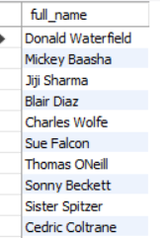
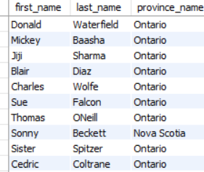
6. Show first name and last name concatenated into one column to show their full name.
SELECT concat(first_name, ' ', last_name) AS full_name FROM patients;
7. Show first name, last name, and the full province name of each patient.
SELECT p.first_name ,p.last_name,pr.province_name FROM patient p JOIN province_names pr ON p.province_id = pr.province_id;

Slide 7

8---Show how many patients have a birth_date with 2010 as the birth year.
SELECT COUNT(*) FROM patients WHERE YEAR(birth_date) = 2010;

Slide 8

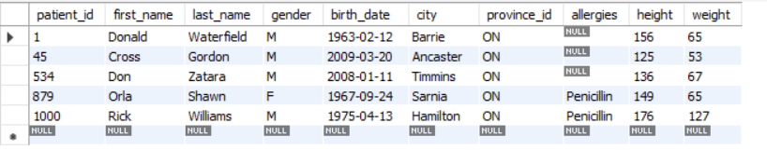
9. Show the first_name, last_name, and height of the patient with the greatest height.
SELECT first_name, last_name , height FROM patients ORDER BY height DESC LIMIT1;
10. Show all columns for patients who have one of the following patient_ids: 1,45,534,879,1000
SELECT * FROM patients WHERE patient_id IN (1,45,534,879,1000);

Slide 9

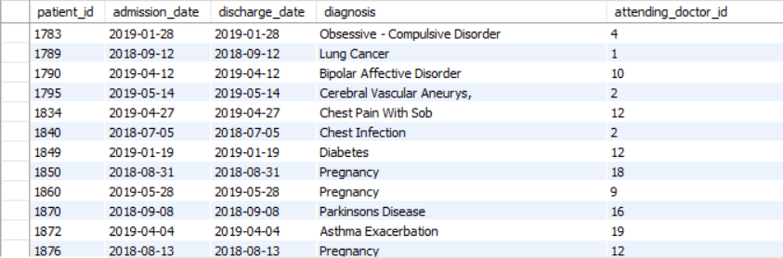
11. Show the total number of admissions.
SELECT COUNT(*) AS total_admissions FROM admissions;
12. Show all the columns from admissions where the patient was admitted and discharged on the same day.
SELECT * FROM admissions WHERE admission_date = discharge_date;

Slide 10

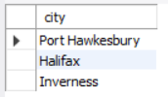
13. Show the total number of admissions for patient_id 579.
SELECT COUNT (*) FROM admissions WHERE peatient_id = 579;
14. Based on the cities that our patients live in, show unique cities that are in province_id 'NS'?
SELECT DISTINCT city FROM patients WHERE provine_id = “NS”;

Slide 11

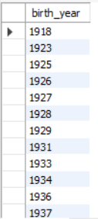
15. Write a query to find the first_name, last name and birth date of patients who have height more than 160 and weight more than 70
SELECT first_name , last_name , birth_date WHERE height = 160 AND weight = 70;
16. Show unique birth years from patients and order them by ascending.
SELECT DISTINCT YEAR (birth_date) AS birth_year ORDER BY birth_year ASC;

Slide 12
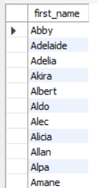
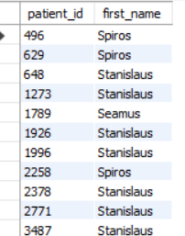
17. Show unique first names from the patients table which only occurs once in the list
SELECT first_name FROM patients GROUP BY first_name HAVING COUNT(*) = 1;
18. Show patient_id and first_name from patients where their first_name start and ends with 's' and is at least 6 characters long.
SELECT patient_id , first_name FROM patients WHERE first_name LIKE “s%s AND CHAR_LENGHT(first_name) >= 6;

Slide 13
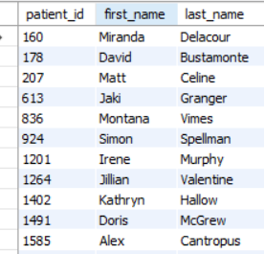
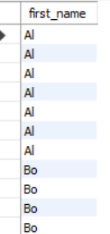
19.Show patient_id, first_name, last_name from patients whos diagnosis is 'Dementia'. Primary diagnosis is stored in the admissions table
SELECT p.patient_id ,p.first_name , p.last_name FROM patients p JOIN a.admissions ON p.patient_id =a.patient_id
WHERE a.diagnosis = ‘Dementia’;
20. Display every patient's first_name. Order the list by the length of each name and then by alphabetically.
SELECT first_name FROM patients ORDER BY CHAR_LENGTH(first_name) , first_name;

Slide 14

21. Show the total amount of male patients and the total amount of female patients in the patients' table. Display the two results in the same row
SELECT COUNT( CASE WHEN gender = "M" THEN 1 END) AS male_count,COUNT( CASE WHEN gender = "F" THEN 1 END) AS female_count FROM patients;
22.SAME Questions
SELECT COUNT( CASE WHEN gender = "M" THEN 1 END) AS male_count,COUNT( CASE WHEN gender = "F" THEN 1 END) AS female_count FROM patients;

Slide 15
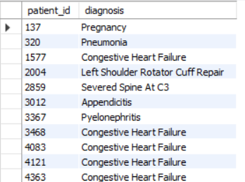
23.Show patient_id, diagnosis from admissions. Find patients admitted multiple times for the same diagnosis
SELECT patient_id , diagnosis FROM patients GROUP BY patient_id , diagnosis HAVING COUNT(*) >1;

Slide 16
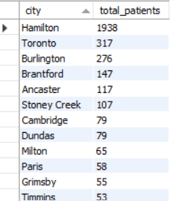
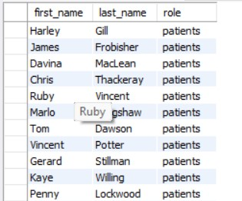
24. Show the city and the total number of patients in the city. Order from most to least patients and then by city name ascending.
SELECT city, COUNT(*) AS total_patients FROM patients GROUP BY city ORDER BY total_patients DESC,city ASC;
25. Show first name, last name and role of every person that is either patient or doctor. The roles are either "Patient" or "Doctor"
SELECT first_name, last_name “patients” AS role FROM patients
UNION ALL
Select first_name, last_name “doctors” AS role FROM doctors ;

Slide 17
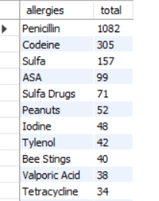
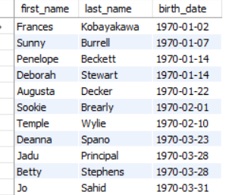
26. Show all allergies ordered by popularity. Remove NULL values from query.
SELECT allergies,Count(*) AS total WHERE allergies IS NOT NULL GROUP BY allergies Order BY total DESC;
27. Show all patient's first_name, last_name, and birth_date who were born in the 1970s decade. __Sort the list starting from the earliest birth_date
SELECT first_name ,last_name , birth_date FROM patients WHERE birh_date >= “1970-01-01” AND birth_date < “1980-01-01” ORDER BY birth_date ASC;

Slide 18

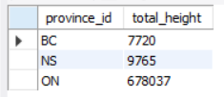
28. We want to display each patient's full name in a single column. Their last_name in all upper letters must appear first, then first_name in all lower case letters. Separate the last_name and first_name with a comma. Order the list by the first_name in decending order EX: SMITH,jane-
SELECT CONCAT(UPPER(last_name) “,” lower(first_name)) AS full_name FROM patients ORDER BY full_name DESC;
29. Show the province_id(s), sum of height; where the total sum of its patient's height is greater than or equal to 7,000.;
SELECT province_id , SUM(height) AS total_height GROUP BY province_id HAVING SUM(height) >= 7000;

Slide 19

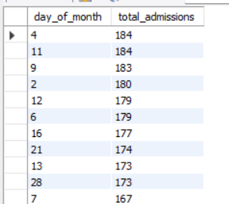
30. Show the difference between the largest weight and smallest weight for patients with the last name 'Maroni'
SELECT MAX(weight) – MIN(weight) AS weight_difference FROM patients WHERE last-name = “Maroni”;
31. Show all of the days of the month (1-31) and how many admission_dates occurred on that day. Sort by the day with most admissions to least admissions'
SELECT DAY(admission_date) AS day_of_month, COUNT(*) AS total_admissions FROM admissions GROUP BY day_of_month ORDER BY total_admissions DESC;

Slide 20
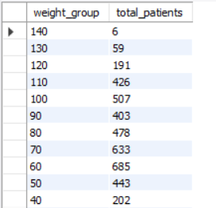
32. Show all of the patients grouped into weight groups. Show the total amount of patients in each weight group. Order the list by the weight group decending. e.g. if they weight 100 to 109 they are placed in the 100#__ weight group, 110-119 = 110 weight group, etc.
SELECT FLOOR(weight / 10) * 10 AS weight_group, COUNT(*) AS total_patients
FROM patients
GROUP BY weight_group
ORDER BY weight_group DESC;

Slide 21
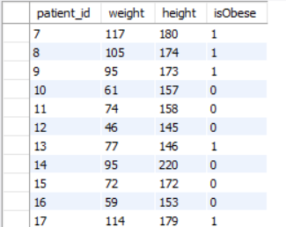

33.Show patient_id, weight, height, isObese from the patients table. Display isObese as a boolean 0 or 1. Obese is defined as weight(kg)/(height(m). #--Weight is in units kg. Height is in units cm.
SELECT patient_id, weight, height, CASE WHEN weight / POWER(height / 100, 2) >= 30 THEN 1 ELSE 0 END AS isObese FROM patients;
34. Show patient_id, first_name, last_name, and attending doctor's specialty. Show only the patients who has a diagnosis as 'Epilepsy' and the doctor's first name is 'Lisa'.#-- Check patients, admissions, and doctors tables for required information.
SELECT p.patient_id, p.first_name, p.last_name, d.specialty FROM patients p JOIN admissions a ON p.patient_id = a.patient_id JOIN doctors d ON a.attending_doctor_id = d.doctor_id WHERE a.diagnosis = 'Epilepsy' AND d.first_name = 'Lisa';

Slide 22
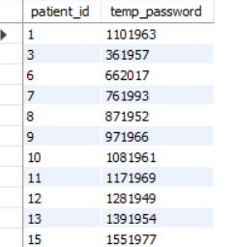
35. All patients who have gone through admissions, can see their medical documents on our site. Those patients are given a temporary password after their first admission. Show the patient_id and temp_password.The password must be the following, in order:- patient_id- -the numerical length of patient's last_name- year of patient's birth_date
SELECT
p.patient_id,
CONCAT(
p.patient_id,
CHAR_LENGTH(p.last_name),
YEAR(p.birth_date)
) AS temp_password
FROM patients p
JOIN admissions a ON p.patient_id = a.patient_id
GROUP BY p.patient_id, p.last_name, p.birth_date;

Slide 23

Total Patients & Total Unique Diagnoses
Explanation:
I created two summary cards to show the total number of patients and total number of unique diagnosis.
This gives a quick top-level view of how many people were recorded and how many types of issue were diagnosed.

Slide 24
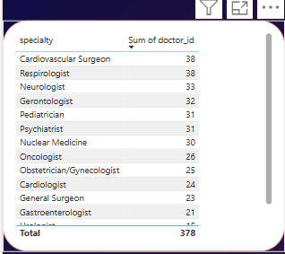
Table / Doctors and Specialities
The Table shows how many doctors belong to each specialty. It helps identified which department are most staffed.

Slide 25
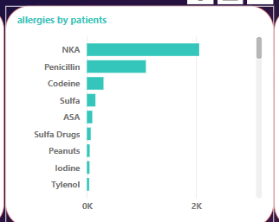
Allergies Reported by Patients (Stacked Bar Chart)
This chart displays the types of allergies reported by patients, broken down by categories.
It helps identify most common allergies and any patterns in reporting by subgroups.

Slide 26
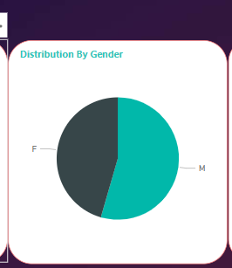
Gender Distribution (Pie Chart)
“This pie chart shows the proportion of male and female patients. It quickly visualizes the gender breakdown of all records and highlights whether there's a balanced or skewed dataset.

Slide 27
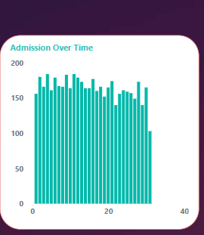
Admissions Over Time (Line and Stacked Column Chart)
“This visual tracks how admissions changed over time (by month or year). The line shows overall trends, while the stacked bars may represent diagnosis type, city, or doctor. It helps understand peak periods or medical surges.”

Slide 28
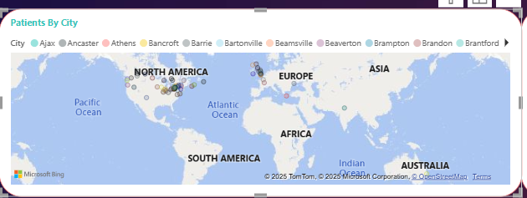
Map – Patients by City
“This map chart shows the geographic distribution of patients across various cities

Slide 29
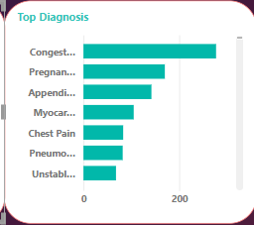
Top Diagnoses (Bar or Column Chart)
This chart displays the most commonly reported diagnoses from the admissions data. It highlights the top medical conditions being treated, helping understand the focus areas of patient care.

Slide 30
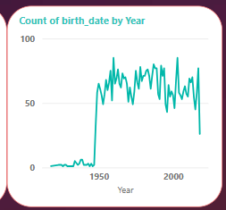
Count of Births by Year (Line Chart)
This visual shows the number of patients grouped by their year of birth. It gives insight into the age distribution of the patient population. Peaks may reflect baby booms or common age groups seeking treatment
Why it's important: It shows demographic spread (younger vs older patients) in your dataset

Slide 31
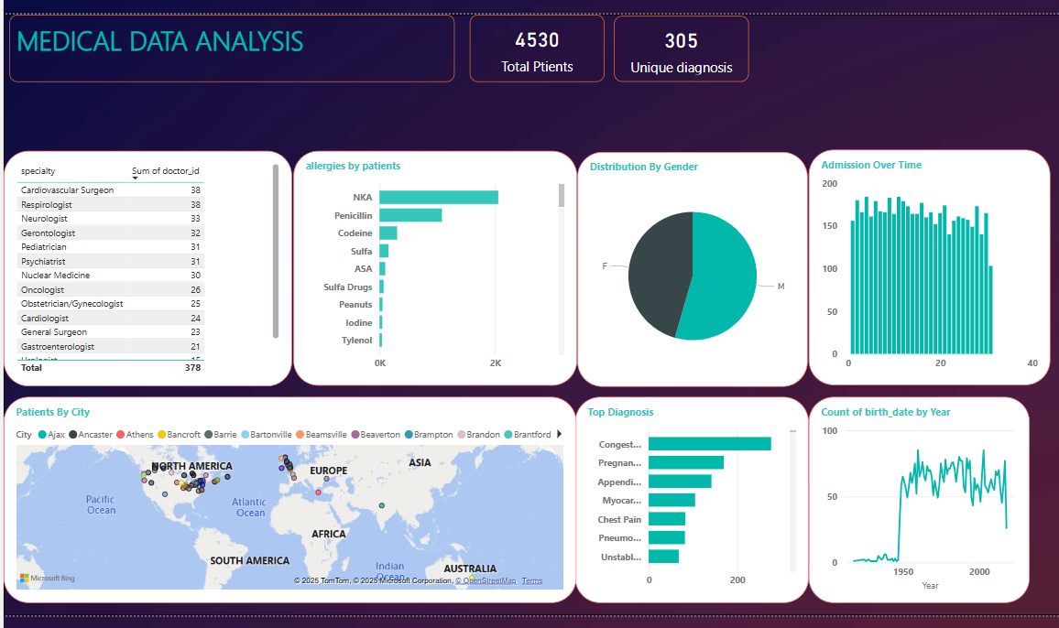
DASHBOARD

Slide 32
DASHBOARD EXPLANTION
“This complete dashboard was built using Power BI to visually summarize key insights from the medical database. It includes a combination of KPI cards, charts, maps, and tables that represent patient demographics, diagnosis patterns, doctor specialties, allergy reports, and admissions over time. The dashboard was created using data extracted through SQL queries and designed to provide a clear, interactive, and data-driven overview of the healthcare dataset. It helps in identifying trends, analyzing operational areas, and supporting decision-making with visual clarity.”

Slide 33
Recommended Actions (Prescriptive Analysis)
Standardize and complete allergy data to reduce clinical risk.
Deploy more doctors in high-demand specialties based on diagnosis trends.
Strengthen healthcare infrastructure in cities with high patient density.
Prepare resources for seasonal spikes by monitoring admission patterns.

